Slide 1
Convolutional Neural Networks for Image Classification
An Example on Seafloor Pockmark Seismic Images
Owen Huff

Slide 2
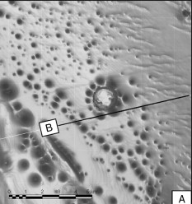
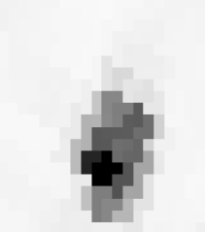
Problem to Solve
10 km
Pockmarks are depressions on the ocean floor typically associated with the release of fluids (such as gas or water)
In seismic variance data, they usually present as pixelated blobs 50-500 meters wide
Can we train a machine learning model to automatically identify them?
10 km
Much higher resolution in bathymetry, vs. seismic…
200 m
200 m

Slide 3
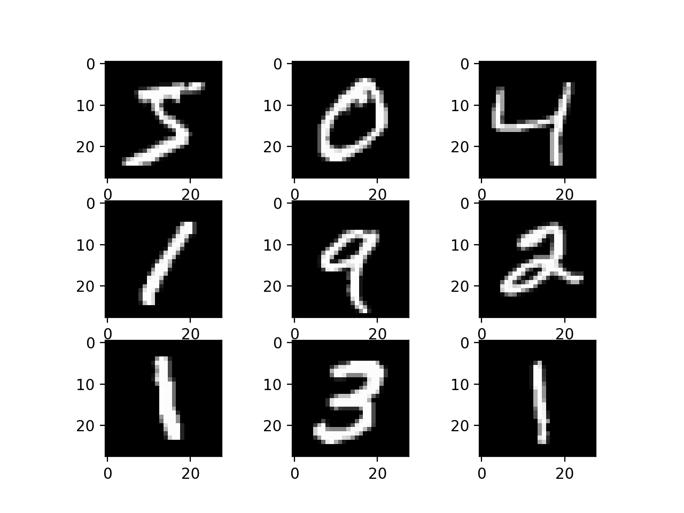
Convolutional Neural Networks
Commonly used for tasks involving image classification, transformation, interpolation, etc.
Most popular examples: networks that can predict the type of handwritten number; whether an image is a cat or dog

Slide 4

CNNs Continued
Typically consist of:
convolutional layers
max pooling
fully-connected (dense) neural network

Slide 5
Convolutional Layers
Scan across an image and make a lower dimensional (simpler) version of it
Have filters which tend to extract different parts of images
The side of a 7, the right and left part of a 4, etc.
These simpler representations are easier for the network to learn

Slide 6
Max Pooling
Put in between convolutional layers, to downsample (or reduce) to more simple features
Takes the maximum values scanning across the convolution results

Slide 7
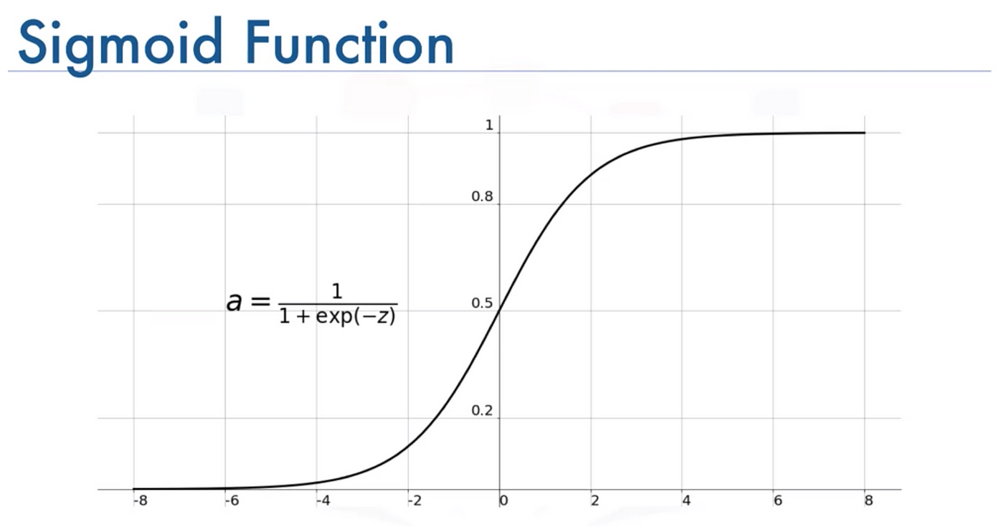
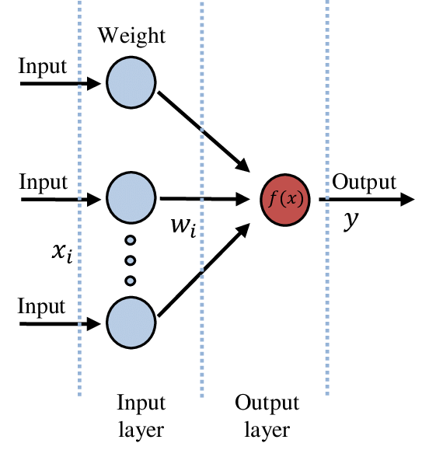
Fully-connected (dense) Layer
Takes all the input features from convolutions, and multiplies them with “weights” to produce an output
Weights are just numbers that are updated each time to produce a better result
Output goes through an “activation function”
Depends on the type of problem
For binary classification – the Sigmoid function probability
< 0.5 → No, > 0.5 → yes
yes
no
Yes or No

Slide 8
Learning / Optimization
The neural network learns based on a “loss” function
For binary classification the loss function is “binary cross entropy” (BCE)
The difference between the predicted probability, and the true label (0 or 1)
The network scans through all the training data (doing this once is called an “epoch”), and then updates all the weights to try to achieve a lower error

Slide 9
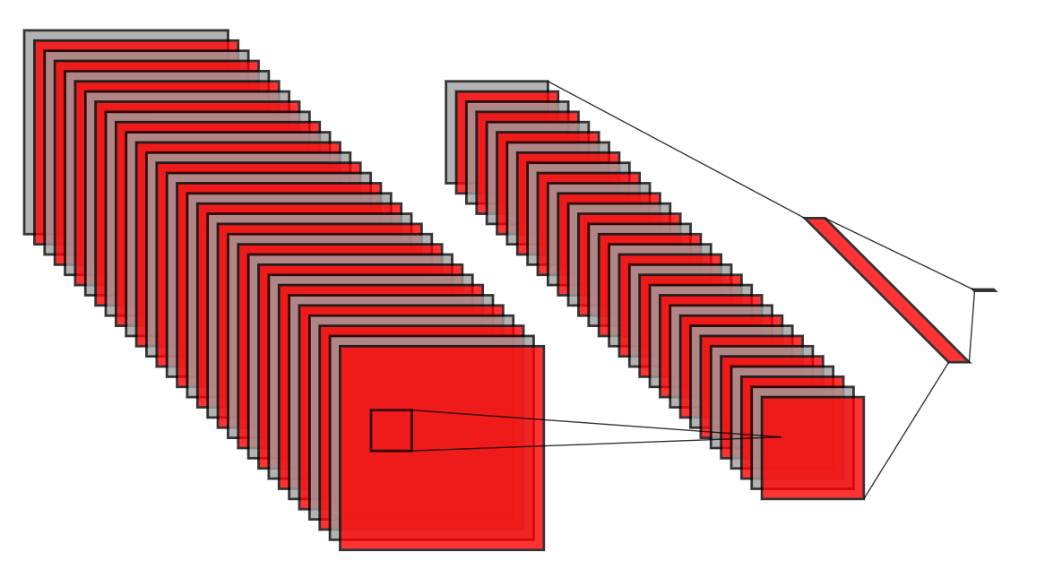

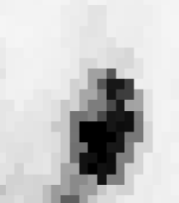
Our CNN
Simple lightweight architecture that takes an image outputs a probability for classification
Convolutions (32 layers)
Max Pooling (downsamples by factor of 4)
Dense Neural Network (100 layers)
Output value (sigmoid, [0,1])

Slide 10
Demonstration Time

Slide 11
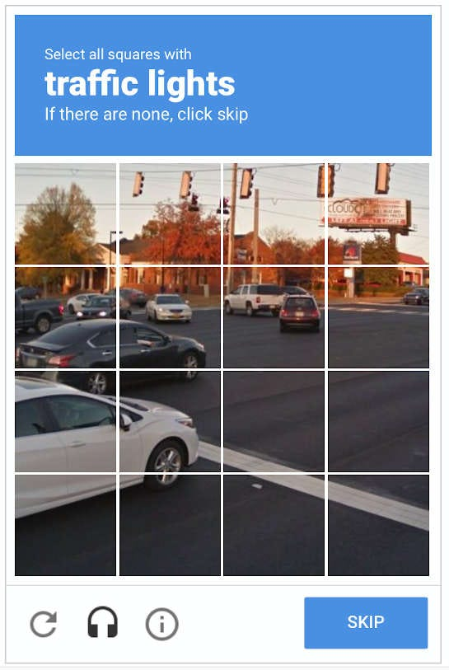
It’s (mostly) About the Training Data
Neural networks are not actually smart
You usually need to show the network thousands (or millions) of examples with labels for it to learn
Often difficult to obtain enough data and label the examples
Sometimes “synthetic” data is created through modeling instead (but then it needs to be realistic enough)
There are some “pre-trained” models (VGG-19, Meta Segment Anything, etc.) but are usually better for common images
Might work for rocks!
You are training Google’s models when you do these

